Slide 1

Susan Supina, JD
Susan Supina teaches compliance, ethics, and business law at the University of St. Thomas Opus College of Business. Prior to joining St. Thomas, Supina served as general counsel and managing director of governance, risk and compliance for LegalResearch.com, a legal services company. She also worked in private practice and as a licensed customs broker. Supina’s professional background includes corporate compliance, business-to-business contracting, international trade, and employment issues. She holds a JD from the University of Minnesota and an LLM from University College London, England.

Slide 2
The Differences (and Similarities) between Law and Ethics
Susan Supina, J.D. (Minn.), LL.M. (Lond.)
University of St. Thomas - Opus College of Business
May 2022

Slide 3
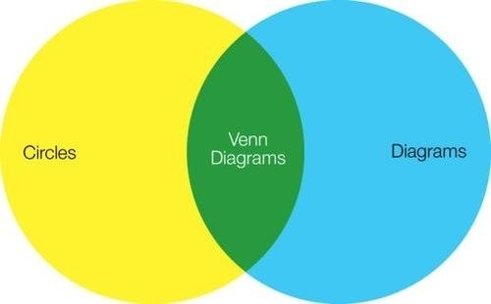
Ethics v. Law

Slide 4
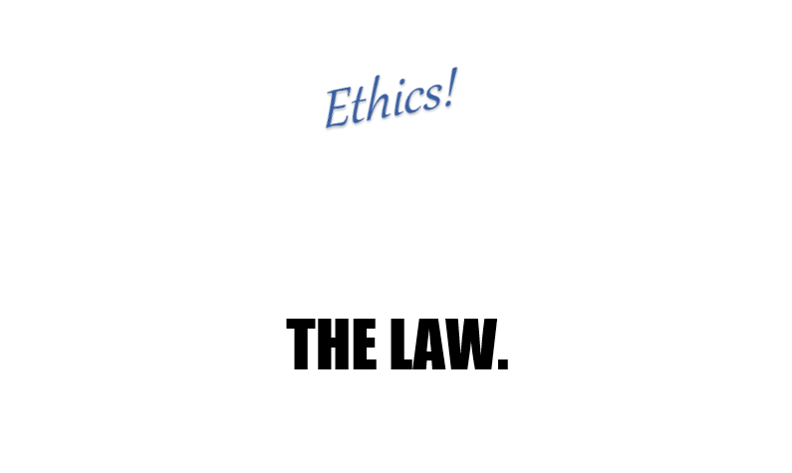
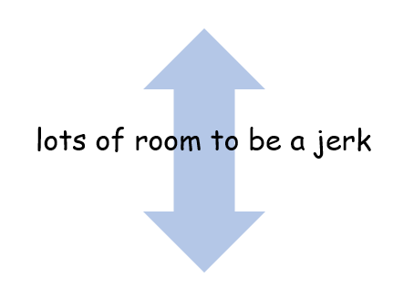

Slide 5
Ethics
Ethics is a guide to human conduct using reason. An agent chooses the best morally right action based on reason, in light of the interest of each individual affected by the action.
- Kara Bhala, Seven Pillars Institute

Slide 6
Ethics
a guide to human conduct based on reason [driven by the] interest of each individual affected
Ethics is a guide to human conduct using reason. An agent chooses the best morally right action based on reason, in light of the interest of each individual affected by the action.
Ethics is a guide to human conduct using reason. An agent chooses the best morally right action based on reason, in light of the interest of each individual affected by the action.

Slide 7
Law
A body of rules of action or conduct prescribed by controlling authority and having binding legal force; that which must be obeyed and followed by citizens subject to sanctions or legal consequences.
- Black’s Law Dictionary

Slide 8
Law
body of rules prescribed by controlling authority which must be obeyed subject to sanctions
A body of rules of action or conduct prescribed by controlling authority and having binding legal force; that which must be obeyed and followed by citizens subject to sanctions or legal consequences.
A body of rules of action or conduct prescribed by controlling authority and having binding legal force; that which must be obeyed and followed by citizens subject to sanctions or legal consequences.

Slide 9

Legal but Unethical

Slide 10
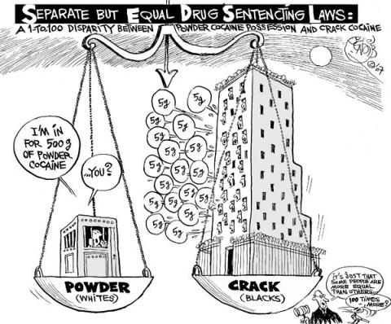
Unethical Laws

Slide 11

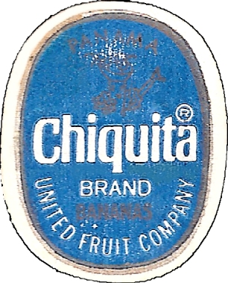
Impact of Unethical Corporate Behavior
Foreign Corrupt Practices Act
  Illegal to bribe foreign officials
  Increased recordkeeping requirements

Slide 12

Impact of Illegal & Unethical Corporate Behavior
Sarbanes Oxley Act
  Added financial records requirements
  Enhanced accountability and reporting rules

Slide 13

Impact of Unethical Corporate Behavior
Turing Pharmaceuticals
  Manipulated single-source drug pricing
  Led by punchable individual
  Prison sentence and corporate turmoil

Slide 14

Ethics as Market Qualifier
Perception of ethical behavior important to potential customers
Customer delight evaporates quickly in face of scandals
Public sentiment can influence business decisions

Slide 15
Modern Approach: Law + Ethics
“Ethical culture” now major consideration in compliance models
Ethics as part of the legal standard

Slide 16
Fed. Sentencing Guidelines for Orgs
§8B2.1. Effective Compliance & Ethics Program
(a) … an organization shall—
1. exercise due diligence to prevent and detect criminal conduct; and
2. otherwise promote an organizational culture that encourages ethical conduct and a commitment to compliance with the law.

Slide 17
FSGO: Seven Pillars on Two Foundations
1. Processes & procedures | 2. High-level oversight | 3. Excluding bad actors | 4. Communications/training | 5. Audit & monitoring | 6. Response & enforcement | 7. Reporting/correction
Foundations: (1) Due diligence & (2) Ethical culture

Slide 18
Lumber Liquidators Settlement (2019)
Settlement with Dep’t of Justice for $33 million
Made materially false and misleading statement to investors
U.S. Attorney: Settlement recognizes cooperation and that the company “completely replaced its senior executive team, and installed experienced executives who have displayed a commitment to building an ethical corporate culture.”

Slide 19
FSGO Culpability Score
Severity of offense determines base fines or penalties.
Aggravating and mitigating factors added to base.
  Aggravating factors: high-level complicity, past misconduct, willful obstruction
  Mitigating factors:
    “Effective” compliance program
    Ethical culture

Slide 20


“Ethical Corporate Culture”: That Sounds Nice!
Actually, it is nice.
  Decreased criminality
  Improved productivity & morale
  Reduced employee turnover

Slide 21
Thanks! supi3375@stthomas.edu

