Slide 1

Weston Lewis, PE
Weston has been working in automation and process optimization since 2012 and has been doing so at Excel Engineering since 2019. Prior to Excel, Weston worked in the industrial silica industry and developed processes and controls for industrial burners and driers, chemical coaters, industrial water treatment facilities, pumping and material handling systems, dust and fume collection, and more. He graduated from the University of Wisconsin - Madison with a bachelor's degree in Chemical Engineering and is a registered Professional Engineer in Wisconsin and Minnesota, as well as several other states.

Slide 2


Closed Loop Process Modelling
Weston Lewis, PE

Slide 3


Agenda
Introduction and Motivation
  Types of Process Responses
  Graphical Estimation
  Numerical Estimation
Applications
  Industry Needs
  Practical Demonstration

Slide 4
What is Model Acquisition?

Slide 5
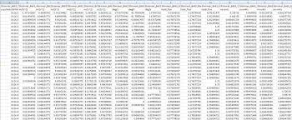
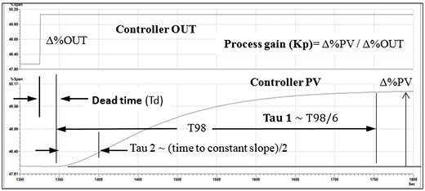
Raw Data Process Model

Slide 6

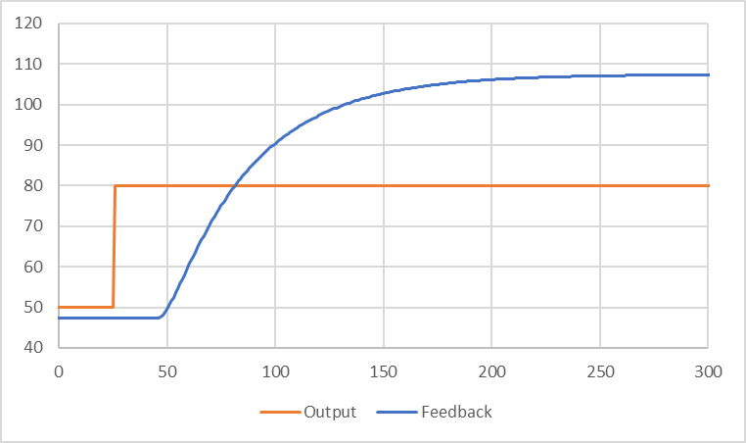
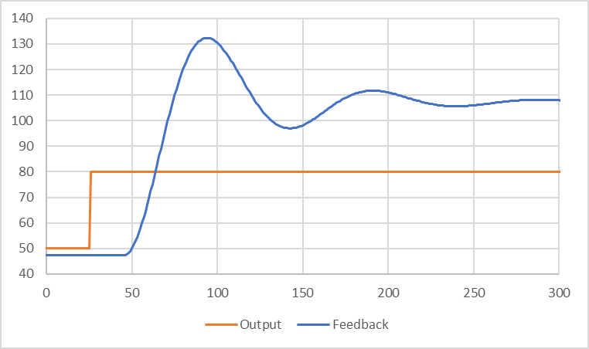

Self-Regulating Responses
First Order Plus Time Delay
$H\left(s\right)=\frac{K_{p}}{τs+1}e^{−θs}$
Second Order Plus Time Delay
$H\left(s\right)=\frac{K_{p}}{τ^{2}s^{2}+2ζτs+1}e^{−θs}$
Higher Order, Inverse Response, Variable Gain

Slide 7
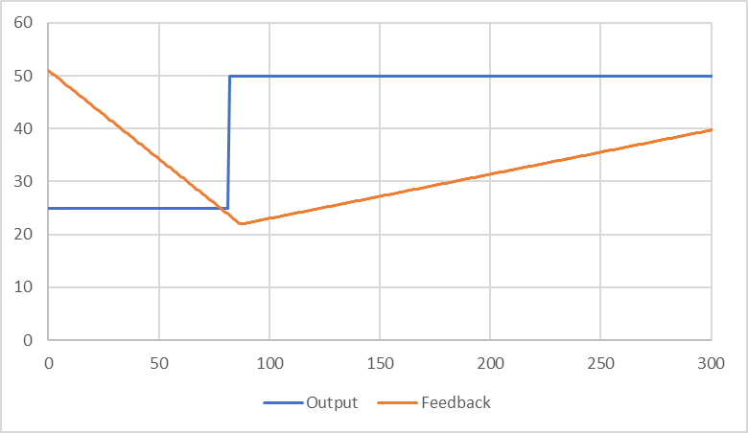
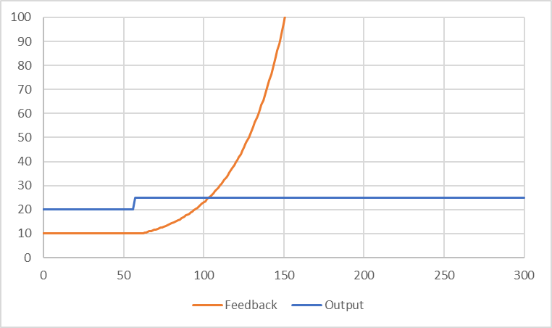

Non-Self-Regulating Responses
Integrating Plus Time Delay
$H\left(s\right)=\frac{K_{p}}{s}e^{−θs}$
Unstable Plus Time Delay
$H\left(s\right)=\frac{K_{p}}{τs−1}e^{−θs}$

Slide 8
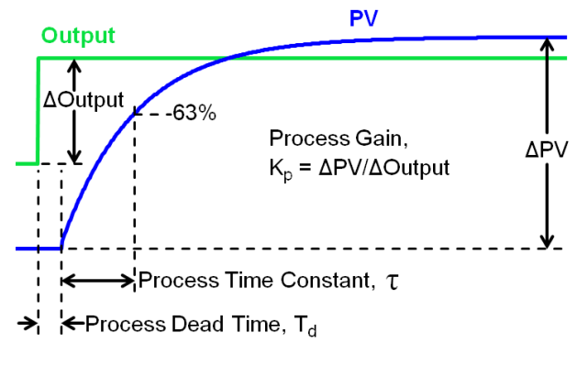
Graphical Estimation
Useful only for certain processes
Qualitative in nature
Requires open loop response data (step testing)
  Often requires downtime

Slide 9
Numerical Estimation
Useful for any process where the response type is known
Quantitatively optimize for best fit
Works for any arbitrary output curve
Can be done online!

Slide 10
So what?

Slide 11



In the Real World

Slide 12
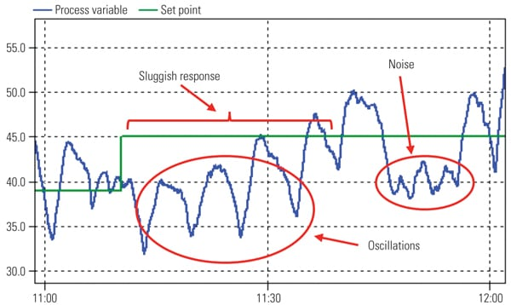
Better Loop Tuning
A 2012 study by the ARC Advisory Group in US chemical plants found:
30% of loops are in manual
20% have factory default tuning
50% increase variability in auto mode!

Slide 13
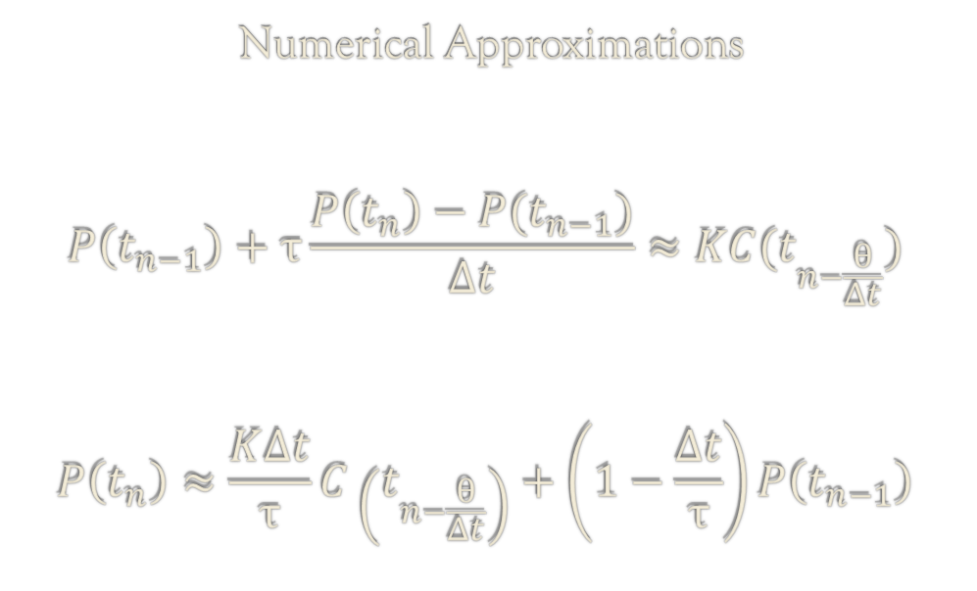
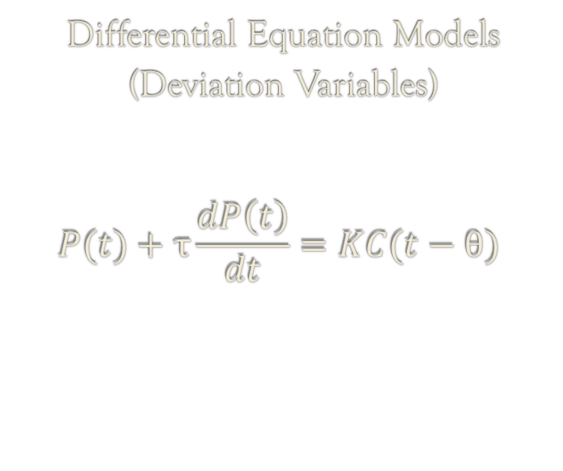
How Does It Work?
Differential Equation Models (Deviation Variables)
$$P(t)+τ\frac{dP\left(t\right)}{dt}=KC(t−θ)$$
Numerical Approximations
$$P\left(t_{n−1}\right)+τ\frac{P\left(t_{n}\right)−P(t_{n−1})}{Δt}≈KC(t_{n−\frac{θ}{Δt}})$$
$$P\left(t_{n}\right)≈\frac{K∆t}{τ}C\left(t_{n−\frac{θ}{Δt}}\right)+\left(1−\frac{Δt}{τ}\right)P\left(t_{n−1}\right)$$

Slide 14
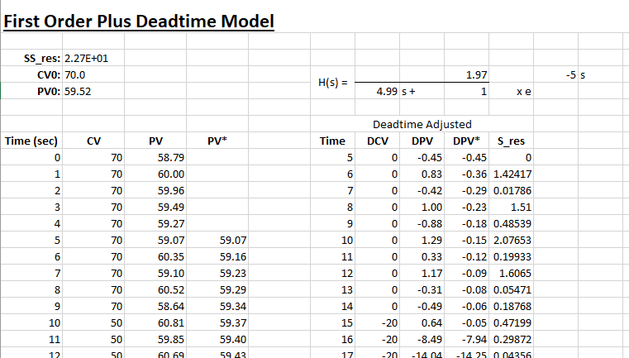
How Does It Work?

Slide 15
The Takeaway
Decreased commissioning time
Improved loop performance
Quantitative performance comparisions

